Slide 1
Ravensky City
A Ravenworld Game

Slide 2
What is Ravensky City?
A floating city in the clouds, overrun by flora
  “Atlantis in the Sky”
Similarities to Ravenwood Fair:
  Build & Decorate
  Collect Pickups
  Complete Quests
  Charming Characters to Nurture
  Beautiful Art
Differences from Ravenwood Fair:
  Setting – ruined city, more majestic
  Unlockable Persistent Mini-maps
  More exploration/discovery
  Instead of chopping down trees, you chop at plants that have overgrown the ruined city and clear rubble
  If RwF is for ladies who like Renaissance Faires, Ravensky is for ladies who like nature, have dreams of flying or like to visit ancient ruins

Slide 3
Setting
Floating city in the clouds
  “Top of the World”
  As you build the city back up, NPCs come to live there, all for their own reasons
Dedicated areas for entrances to mini-maps:
  Airship Dock
  Waterfall
  Ruins entrance
Hints in the background of areas you can eventually head to

Slide 4
The Arrival
An airship crash landing deposits you on this majestic lost city. Obscured by clouds, this city of Ravensky has been adrift for untold centuries. Former gardens have overrun what used to be a bustling city. Discover what has been lost, restore the ancient civilization and build a new destination for visitors to learn about the past.

Slide 5
Phases of City Development
Discovery
Hack away plants & rubble to discover ancient ruins
Learn about original inhabitants
Reclamation
Restore the ruins
Build the city back up
Tourism
As word spreads of your revitalization, tourists arrive from all over to see the return of the grand city

Slide 6
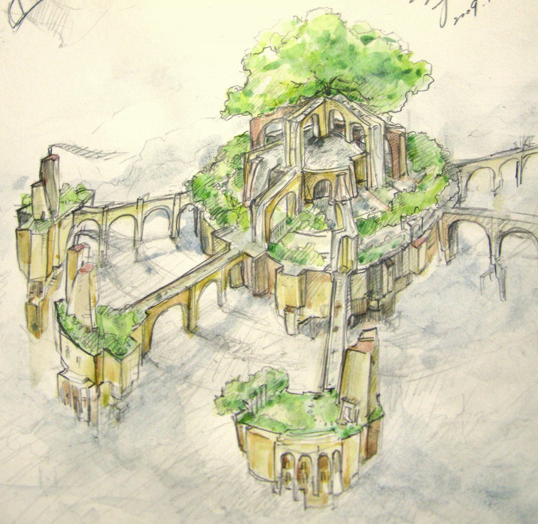
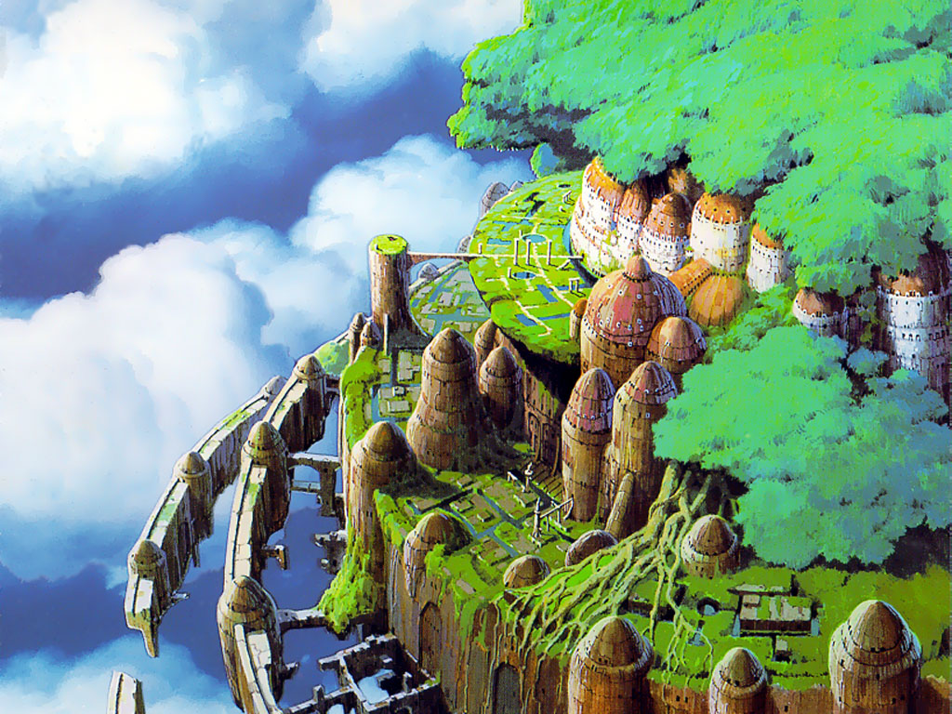
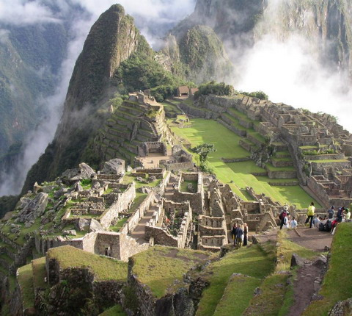
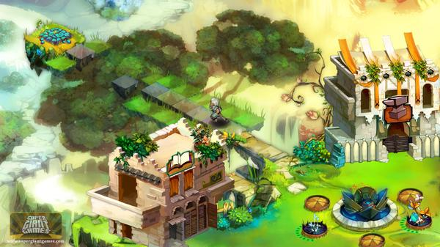
Art Inspiration
Laputa: Castle in the Sky
Air Bender Temples
  (Avatar: The Last Airbender)
Macchu Picchu
Tulum
Hanging Gardens of Babylon

Slide 7
Characters
Visitors
  Many species of birds, with distinct personalities
  Archaeologist
  Zen master
  Burned out surfer
  Get-rich-quick schemer
  Lovable rogue sky pirate
Wind Spirits
  Impish sprites, tough to discern their agenda
  Live in the clouds
  All their magic & technology is wind-powered

Slide 8
The Core Game Loop
Harvest Wood, XP, Coins and Materials from plants Using Energy
Spend
Wood, Coins & Materials
on
Buildings & Nature Attractions
Attract Visitors with Attraction from Nature Attractions & Decorations
Visitors Give You Coins & XP for Using Buildings

Slide 9
Harvesting
Clear rubble from the city streets
Chop down the thorny, aggressively overgrown plants that are overtaking the ruined city
  Get loot for interacting with nature (like RwF):
    Stone
    Coins
    XP
    Materials
      Wild plants, flowers, mushrooms and ancient artifacts
    Monsters

Slide 10
Monsters & Protectors
Monsters
  Robots (sleek automaton)
  Mutated, carnivorous plant
Protectors
  Totems – statues with defensive powers
  Each has a personality, representing an aspect
  All quest-locked at the start, have to find & restore each one on the map to unlock in the store

Slide 11
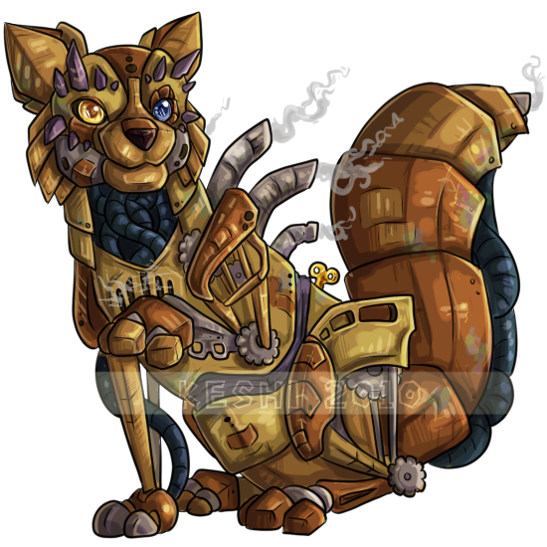
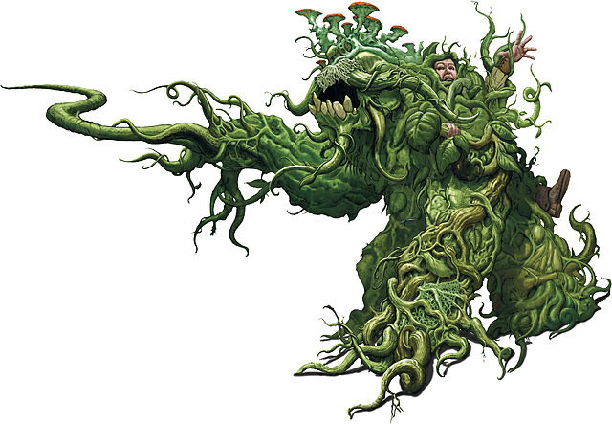
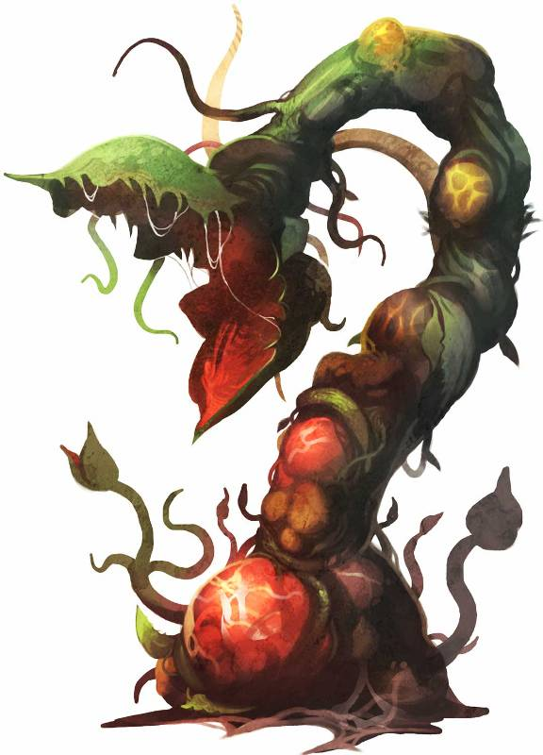
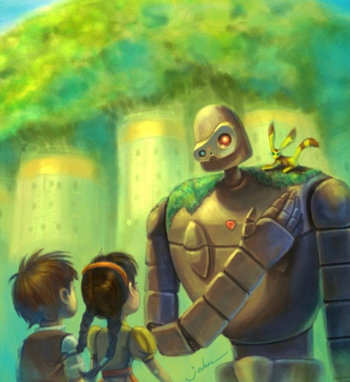
Monsters
Sleek, aerodynamic malfunctioning robots and aggressive, mutated plants pop up from time to time to impede your progress.

Slide 12
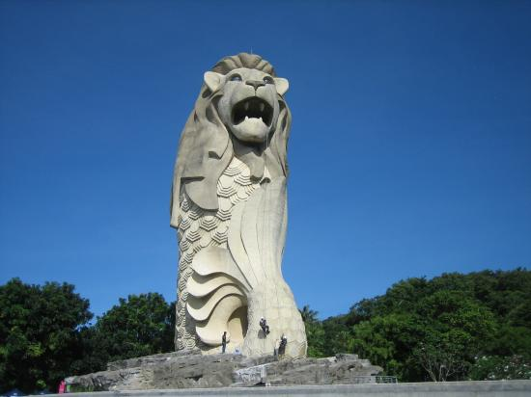
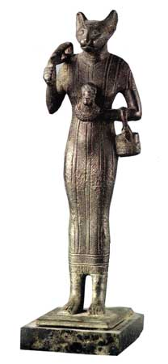
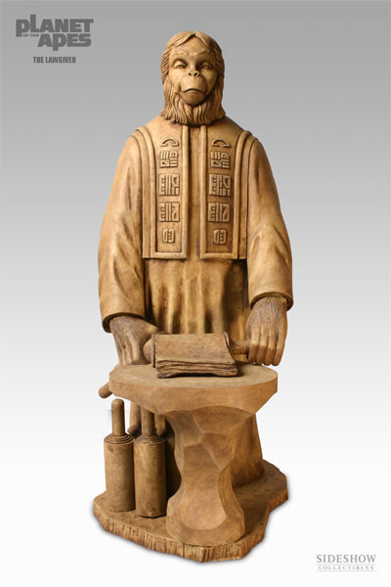
Protectors
Totems/Statues, each with their own personality. Interacting with them allows you to have conversations, learn more of the lost civilization through their riddles

Slide 13

Mentor
We should use Muninn as the mentor in Ravensky City, as has been established in RwF. This will also help to tie the games together a bit more.

Slide 14
Building
Buildings – majestic buildings in the same architectural style as the ruins. Functionality not as important as form and beauty.
  Temple
  Baths
  Cathedral
  Rock garden
  Butterfly conservatory
Garden
  Build non-dangerous plants that you can harvest (appointment mechanic)
Decorations
  Lots of statues, fountains, paths, repaired ancient devices
  Layered decorations (e.g.: lamp on top of path tile)
  Smart path placement (no corners, ends, tops & bottoms in store)

Slide 15
Economy
Buildings & Decorations provide beauty, which attracts visitors
  We’ll lean more heavily on the completion of quests & construction of buildings to attract visitors instead of the beauty rating
Visitors use buildings, add coins & XP to them
You harvest coins & xp from buildings once their ‘hopper’ is full, instead of stocking dimmed, empty buildings

Slide 16
Story/Quests
Clear out aggressive plants, clear rubble
Restore ruins
Attract fortune-seeking visitors
Track down artifacts
Build new structures to flesh out the city
Learn about the lost civilization
Unlock new locations and build there

Slide 17
Where Can We Go From Here?
Persistent mini-maps leave us a lot of room to expand from the start.
  Cloud world
  Ravensky city interior (engine room)
  Other floating islands

Slide 18
Ravenworld Game Interoperability
Receive a welcome pack in either game if you’ve reached at least level 5 in the other.
Augmented daily login bonus gives you a bonus in each game based on how much you play each
We should have a character who comes to the fair, you complete quests for and then she leaves for Ravensky City.
Complete a quest in each game to unlock a building in the other game.
Certain material that exists in both games, but is easier to get in one than the other

Slide 19
Known Engineering Requirements
Persistent Mini-maps
  Load a new map that you can build in, that persists, has a quest completion requirement to unlock
Buildings collect coins & XP as used, until full
Conversing with Protectors
Airship Crash Landing
Layered Decorations
Smart Paths
Cross-Game Integration
  Daily login bonus augmentation
  Quest triggers if you completed a quest in other game
  Unlock a building in each game by completing a quest in the other
  Unlock a welcome pack in each game by reaching level X
  Shared material

